Slide 1
Blockchain Essentials & DApps

Slide 2
Course Outcomes
Student will be able to illustrate the Blockchain terminologies with its applications.- L2
Student will be able to analyze the working principles of Blockchain -L2
Student will be Able to comprehend the principles and methodologies used in Bitcoin –L2
Student will be Able to create Ethereum Network, Wallets, Nodes, Smart contract & DApps –L4
Student will be Able to develop Blockchain Based Application Architecture using Hyperledger –L3

Slide 3
CO-PO Mapping
PO | 1 | 2 | 3 | 4 | 5 | 6 | 7 | 8 | 9 | 10 | 11 | 12 | PSO1 | PSO2
CO1 | 3 |  |  |  |  |  |  |  |  |  |  |  |  | 3
CO2 | 3 | 2 |  |  |  |  |  |  |  |  |  |  |  | 3
CO3 | 3 | 2 |  |  |  |  |  |  |  |  |  |  |  | 3
CO4 | 2 | 2 | 3 |  | 2 |  | 2 |  | 2 | 2 |  | 2 |  | 3
CO5 | 2 | 2 | 3 |  | 2 |  | 2 |  | 2 | 2 |  | 2 |  | 3
14IS71 | 3 | 2 | 3 |  | 2 |  | 2 |  | 2 | 2 |  | 2 |  | 3

Slide 4
Teaching Methodology:
Black board teaching/Power Point Presentations
Hands-on Training
Course Projects.

Slide 5
Assessment Methods
Three internals, 30Marks each will be conducted and the Average of best of two will be taken.
Rubrics evaluation for the Course Project will be conducted for 20 marks.
Final examination, of 100 Marks will be conducted and will be evaluated for 50 Marks.

Slide 6
Course Contents: UNIT-1
Distributed systems, CAP theorem, Byzantine Generals problem, Consensus. The history of blockchain, Introduction to blockchain, Various technical definitions of blockchains, Generic elements of a blockchain, Features of a blockchain, Applications of blockchain technology, Tiers of blockchain technology, Consensus in blockchain, CAP theorem and blockchain, Benefits and limitations of blockchain

Slide 7
Course Contents: UNIT-2
Decentralization using blockchain, Methods of decentralization, Blockchain and full ecosystem decentralization, Smart contract, Decentralized organizations, Decentralized autonomous organizations, Decentralized autonomous corporations, Decentralized autonomous societies Decentralized applications, Platforms for decentralization,
Hash functions: Compression of arbitrary messages into fixed length digest,Easy to compute, Pre-image resistance, Second pre-image resistance,Collision resistance,Message Digest (MD),Secure Hash Algorithms (SHAs), Merkle trees, Patricia trees, Distributed hash tables (DHTs), Digital signatures

Slide 8
Course Contents: UNIT-3
Bitcoin, Bitcoin definition, Transactions, The transaction life cycle, The transaction structure, Types of transaction, The structure of a block , The structure of a block header, The genesis block, The bitcoin network, Wallets, Smart Contracts-History, Definition, Ricardian contracts, Smart contract templates, Oracles, Smart Oracles, Deploying smart contracts on a blockchain, The DAO

Slide 9
Course Contents: UNIT-4
Ethereum 101, Introduction, Ethereum clients and releases, The Ethereum stack, Ethereum blockchain, Currency (ETH and ETC), Forks, Gas, The consensus mechanism, The world state, Transactions, Contract creation transaction, Message call transaction, Elements of the Ethereum blockchain , Ethereum virtual machine (EVM), Accounts, Block, Ether, Messages, Mining, The Ethereum network
Hands-on: Clients and wallets -Geth

Slide 10
Course Contents: UNIT-5
Hyperledger, Hyperledger as a protocol, Fabric, Hyperledger Fabric, Sawtooth lake, Corda

Slide 11
TEXTBOOK
Imran Bashir. “Mastring BlockChain”, Packt
REFERENCEBOOKS
Mastering Bitcoin: Programming the Open Blockchain Paperback – 2017 by Andreas M. O’rielly

Slide 12
Definition of a Distributed System
A distributed system is
a collection of independent computers
that appears to its users
as a single coherent system.
... or ...
as a single system.

Slide 13
Resource Sharing and the Web
Hardware resources (reduce costs)
Data resources (shared usage of information)
Service resources
search engines
computer-supported cooperative working 
Service vs. server (node or process )

Slide 14
Distributed application
one single “system”
one or several autonomous subsystems
a collection of processors
parallel processing
Increased performance, reliability, fault tolerance
partitioned or replicated data
increased performance, reliability, fault tolerance
Dependable systems, grid systems, enterprise systems

Slide 15
Why Distribution?
Sharing of information and services
Possibility to add components improves
availability
Reliability
fault tolerance
performance
scalability

Slide 16
Goals of DS
Making resources accessible
Distribution transparency
Openness
Scalability
Security
System design requirements

Slide 17
Challenges for Making Resources Accessible
Naming
Access control
Security
Availability
Performance
Mutual exclusion of users, fairness
Consistency in some cases

Slide 18
Transparencies
Access : Hide differences in data representation and how a resource is accessed
Location: Hide where a resource is located
Migration :Hide that a resource may move to another location
Relocation :Hide that a resource may be moved to another location while in use (the others don’t notice)
Replication :Hide that a resource is replicated
Concurrency :Hide that a resource may be shared by several competitive users
Failure :Hide the failure and recovery of a resource
Persistence: Hide whether a (software) resource is in memory or on disk

Slide 19
Omission and arbitrary failures
Fail-stop :Process halts and remains halted. Other processes may detect this state.
Crash :Process halts and remains halted. Other processes may not be able to detect this state.
Omission :A message inserted in an outgoing message buffer never arrives at the other end’s incoming message buffer.
Send-omission:A process completes send, but the message is not put in its outgoing message buffer.
Receive-omission : A message is put in a process’s incoming message buffer, but that process does not receive it.
Arbitrary(Byzantine) :Process/channel exhibits arbitrary behaviour: it may send/transmit arbitrary messages at arbitrary times, commit omissions; a process may stop or take an incorrect step.

Slide 20
Timing failures
Clock :Process’s local clock exceeds the bounds on its rate of drift from real time.
Performance : Process exceeds the bounds on the interval between two steps.
Performance : A message’s transmission takes longer than the stated bound.

Slide 21
Failure Handling
More components
increased fault rate
Increased possibilities
more redundancy => more possibilities for fault tolerance
no centralized control => no fatal failure
Issues
Detecting failures
Masking failures
Recovery from failures
Tolerating failures
Redundancy
partial failures

Slide 22
Concurrency
Concurrency:
Several simultaneous users => integrity of data
mutual exclusion
synchronization
transaction processing in data bases
Replicated data: consistency of information?
Partitioned data: how to determine the state of the system?
Order of messages?
There is no global clock!

Slide 23
Challenges for Scalability
The system will remain effective when there is a significant increase in
number of resources
number of users
The architecture and the implementation must allow it
The algorithms must be efficient under the circumstances to be expected

Slide 24
Challenges for Security
Security: confidentiality, integrity, availability
Vulnerable components
channels (links <–> end-to-end paths)
processes (clients, servers, outsiders)
Threats
information leakage
integrity violation
denial of service
illegitimate usage
Current issues:
Denial-of-service attacks, security of mobile code, information flow;
open wireless ad-hoc environments

Slide 25
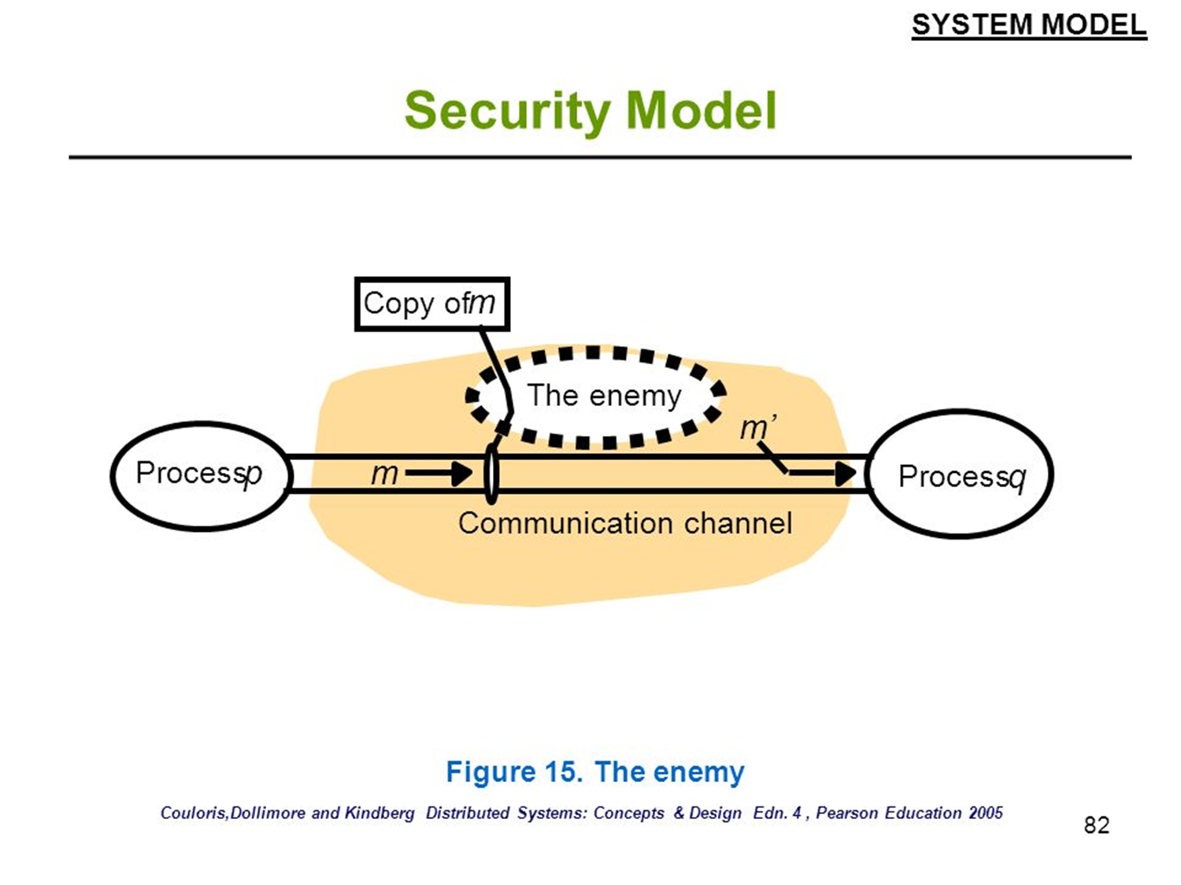

Slide 26
Threats to channels
eavesdropping (data, traffic)
tampering, replaying
masquerading
denial of service
Threats to processes
server: client’s identity;
client: server’s identity
unauthorized access (insecure access model)
unauthorized information flow (insecure flow model)

Slide 27
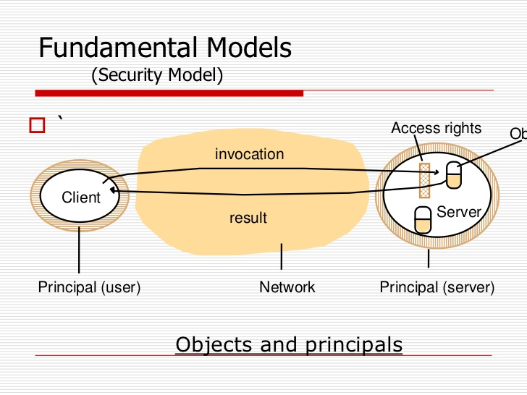

Slide 28
Defeating Security Threats
Techniques
cryptography
authentication
access control techniques
intranet: firewalls
services, objects: access control lists, capabilities
Policies
access control models
lattice models
information flow models
Leads to: secure channels, secure processes, controlled access, controlled flows

Slide 29
Distributed systems
Distributed systems are a computing paradigm whereby two or more nodes work with each other in a coordinated fashion in order to achieve a common outcome
DS modeled in such a way that end users see it as a single logical platform.
Node can be defined as an individual player in a distributed system and and have their own memory and processor.
All nodes are capable of sending and receiving messages to and from each other.
Nodes can be honest, faulty, or malicious

Slide 30
A node that can exhibit arbitrary behavior is also known as a Byzantine node.
This arbitrary behavior can be intentionally malicious, which is detrimental to the operation of the network.
Generally, any unexpected behavior of a node on the network can be categorized as Byzantine.

Slide 31
Challenge in distributed system Design
Coordination between nodes
Fault tolerance.
Even if some of the nodes become faulty or network links break, the distributed system should tolerate
D S should continue to work flawlessly in order to achieve the desired result.
Several algorithms and mechanisms has been proposed to overcome these issues.
Distributed systems are so challenging to design that a theorem known as the CAP theorem has been proved and states that a distributed system cannot have all much desired properties simultaneously.

Slide 32
CAP theorem (Brewer's theorem)
Introduced originally by Eric Brewer in 1998;
in 2002 it was proved as a theorem by Seth Gilbert and Nancy Lynch.
The theorem states that any distributed system cannot have Consistency, Availability, and Partition tolerance simultaneously
Somehow blockchain manages to achieve all these properties

Slide 33
CAP theorem
Consistency is a property that ensures that all nodes in a distributed system have a single latest copy of data
Availability means that the system is up, accessible for use, and is accepting incoming requests and responding with data without any failures as and when required
Partition tolerance ensures that if a group of nodes fails the distributed system still continues to operate correctly

Slide 34
In order to achieve fault tolerance, replication is used.
Consistency is achieved using consensus algorithms to ensure that all nodes have the same copy of data. This is also called state machine replication.
Blockchain is basically a method to achieve state machine replication.

Slide 35
Types of fault
Faulty node has simply crashed
Faulty node can exhibit malicious or inconsistent behavior arbitrarily.
Difficult to deal with since it can cause confusion due to misleading information.

Slide 36
Byzantine Generals problem
In September 1962, Paul Baran introduced the idea of cryptographic signatures with his paper On distributed communications networks.
This is the paper where the concept of decentralized networks was also introduced for the very first time.
Then in 1982 a thought experiment was proposed by Lamport et al. whereby a group of army generals who are leading different parts of the Byzantine army are planning to attack or retreat from a city.
The only way of communication between them is a messenger and they need to agree to attack at the same time in order to win.
The issue is that one or more generals can be traitors and can communicate a misleading message.

